Slide 1
Section 7 Advanced Machine Learning in Watson Studio [Predictive Data Science] [Prescriptive Data Science]

Slide 2
Workshop Agenda – Section 5
Advanced Machine Learning with Watson Studio
Machine Learning Challenges
Model evaluation
Algorithm selection
Bias, Fairness, eXplainable AI
A perspective on Decision Optimization and O/R
Lab 5 - Demo
Model retraining in Watson Studio with Watson Machine Learning
Retrain models based on feedback database

Slide 3
Machine Learning Challenges

Slide 4
Model Evaluation considerations
Once a model has been computed, the issue is to assess its validity
Validity assessment is based on metrics computed on the validation subset
Cross Validation techniques shuffle the train/test sets for higher precision
Accuracy on the test set is not always a precise indicator
The typology of measures depend on the technique
Regression algos use Mean Squared Error, and R-Squared (R^2) metric
Classification algos use metrics such as ROC and PR
Give a measure of the ratio of true vs false positive&negative

Slide 5
Model training – under and overfitting
Balance two goals
Fit train data correctly, i.e. lead to good predictions on train data
Have a model as simple as possible to avoid overfitting.
Overfitting can occur with regression, see blue curve on the right
Underfitting occurs when a model is too sparse

Slide 6
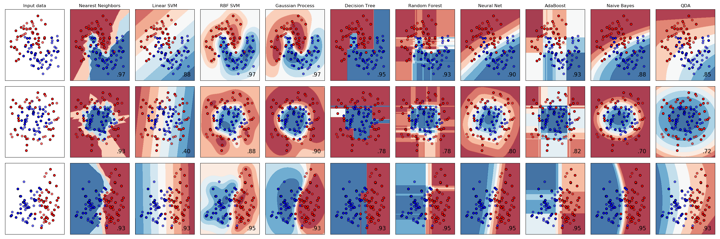
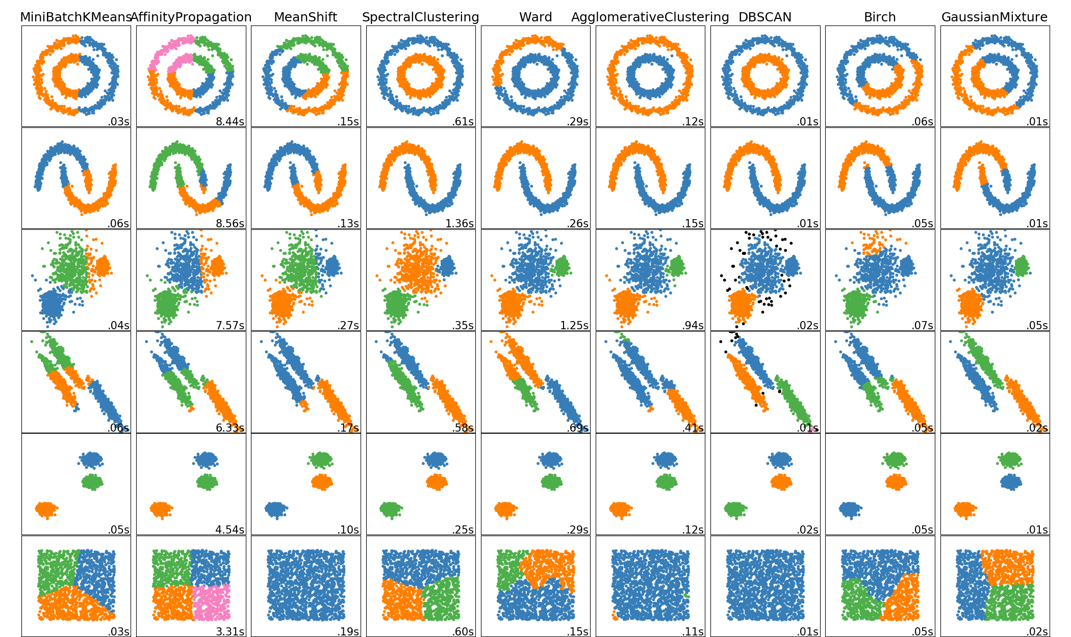
Algorithm selection and tuning
Each technique can have several algorithm implementations that yield different results depending on the shape of the dataset
Classification
Clustering
Regression
http://scikit-learn.org/ stable/auto_examples/classification/plot_classifier_comparison.html
http://scikit-learn.org/ stable/auto_examples/cluster/plot_cluster_comparison.html

Slide 7
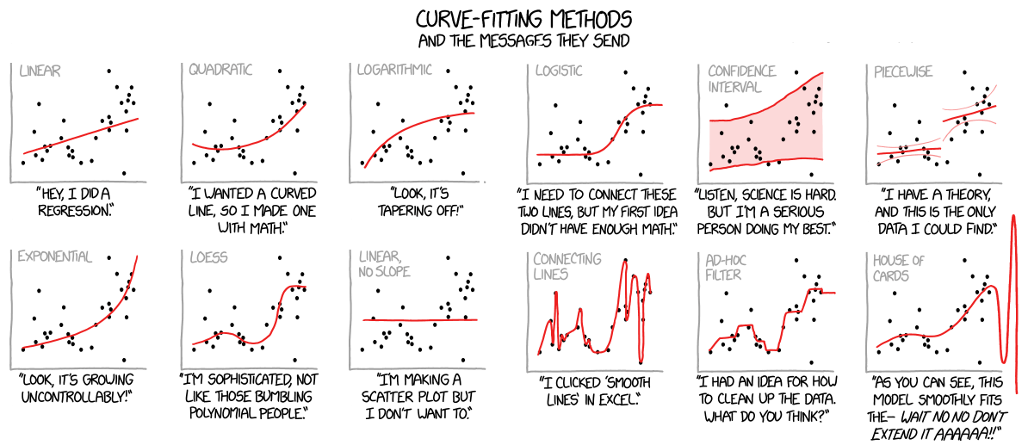
Machine Learning challenges: Regression
https://xkcd.com/2048/
http://www.explainxkcd.com/wiki/index.php/2048:_Curve-Fitting

Slide 8
What are ‘Hyperparameters’
ML Algorithms usually have a set of parameters that can be modified
These are called ‘hyperparameters’
For example, the train/test split ratio can be considered an hyperparameter
Selecting the proper/best hyperparameters is a ML task in itself

Slide 9
Machine learning deployment
Watson Machine Learning
train
infrastructure
deploy
REST
API
prediction
App
REST
API
prediction
App
artifact
repository
hosted
models
REST
API
prediction
App
REST
API
prediction
App

Slide 10



Stability in time: Continuous Learning
Data
Scientist
Operational
Data
Developer
History
Data
Data visualization
Feature engineering
Model training
ML
Model
Model Selection
deploying
scoring
ML Pipeline
Predictions
Feedback Data
ML
Model
retraining
redeploying
monitoring

Slide 11
Explainable AI considerations
Source: DARPA https://www.darpa.mil/program/explainable-artificial-intelligence

Slide 12
Machine Learning interpretability tradeoff
Source: DARPA https://medium.com/ansaro-blog/interpreting-machine-learning-models-1234d735d6c9

Slide 13
AI Asset Lifecycle Management
Use the Watson Knowledge Catalog and Watson Studio to manage your AI assets or manage them yourself
Watson Machine Learning
Model Explanations
In May 2018, the General Data Protection Regulation (GDPR) takes effect and grants consumers the legal “right to explanation” from organizations that use algorithmic decision making.
Training infrastructure
deploy
infrastructure
artifact
repository
Watson Knowledge Catalog
Audit Trails
Tracking prediction to each model’s unique heritage is critical to regulatory compliance. Enforcing access controls for model sharing and deployment ensure ensures data security and application stability.
datasets
source code
pipelines
models
experiment
definitions

Slide 14
Model Bias and Fairness considerations
Model Bias in Trained Models
Age | Income | Dependents | Married | Years Worked | Profession |  | Gender | Nationality | … | APPROVED
33 | 65,000 | 1 | Yes | 8 | Nurse |  | Female | French | … | No
42 | 71,000 | 2 | No | 20 | Teacher |  | Male | German | … | Yes
54 | 84,000 | 1 | No | 34 | Consultant |  | Male | French | … | Yes
… | … | … | … | … | … |  | … | … | … | …

Slide 15
Model Fairness
Monitor how AI makes predictions to individual transactions to ensure it produces fair outcomes.
Input
Model deployment, fairness attribute, favored/protected population, class label, favorable/unfavorable outcome.
Output:
Is the model biased on some attribute for a specific value (Gender=Female)
What is the source of the bias? (Model is biased for loan amount > $2M)
Data which can be sent for manual labelling which will help mitigate bias.
Natural language explanation of how bias was computed and detected

Slide 16
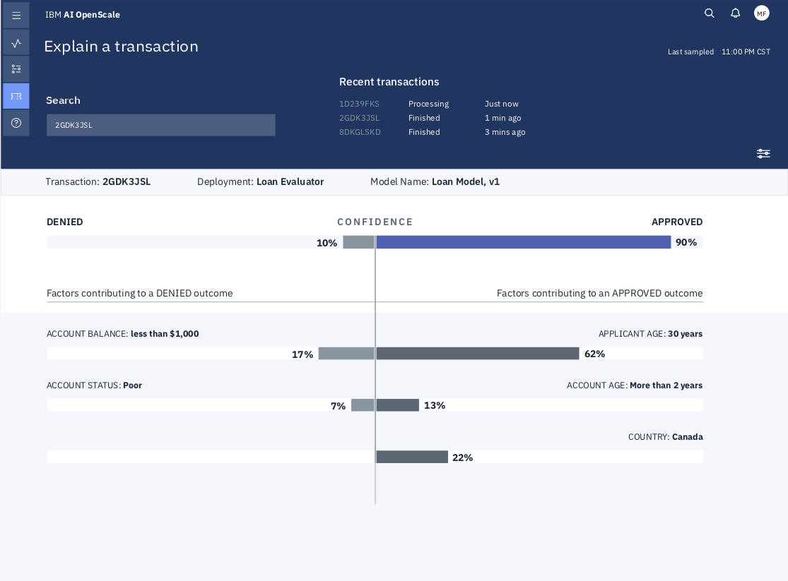
Model Explainability
Description:
Allows operations users to query based on a business transaction ID and obtain an explanation of why an AI recommendation was made in terms they understand
Value Add:
Request an explanation for prediction so any business user or operations engineer can understand how the model arrived at it’s outcome
Delivers Trust in AI by providing transparency into how AI is effecting business outcomes
Provides insight into potential issues with model fairness or skew

Slide 17
AI Open Scale:

Slide 18




I won’t built an AI System that I can’t understand. What can I do?
Satisfied customer?
IBM AI OpenScale
100% understandable
yes
business owner
I don’t want to waste time. Are there out-of-the-box tools and frameworks to deploy and instrument my AI System?
nothing
Deployed AI System
priceless
IT and dev ops
0% of potential AI Systems allowed to proceed
yes
Improved performance of AI system from 50% to 300%
3-5x reduction in time-to-market
3-5x reduction in time-to-market
If my AI System isn’t instrumented then I can’t understand and improve it. Can I get all system sessions monitored and traced down to individual predictions?
yes
data science team
IBM Cloud / Watson and Cloud Platform / © 2018 IBM Corporation

Slide 19
Advanced ML techniques

Slide 20
More topics
Random Forest
Binary Classification
ROC Curve
Decision Trees
Principal Component Analysis
Clustering methods
http://scikit-learn.org/stable/modules/clustering.html#overview-of-clustering-methods

Slide 21
Prescriptive Data Science: Decision Optimization

Slide 22





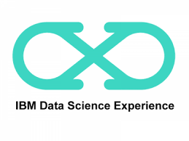


IBM Data Science & Business Analytics Portfolio
What is our plan?
IBM Planning Analytics
Planning
Planning, budgeting, and
forecasting
What should we do?
What happened?
IBM Decision Optimization
Governance & Trusted Data
IBM Cognos Analytics
Prescriptive
Descriptive
Collaborate for maximum business
value, informed by advanced analytics
Get in touch with reality, a
single source of the truth, visibility
What will happen next?
Why did it happen?
IBM SPSS
IBM Data Science Experience
IBM Watson Explorer
Data Augmentation and
Contextualization
Unstructured Data
Predictive
Understand the most likely future
scenario and its business implications
IBM Watson Analytics
Structured Data
Diagnostic
Understanding why something
happened is a critical step
Notes:
IBM is unique in its ability to deliver on this lifecycle of turning data into insight and insight into action. IBM Planning Analytics provides a market leading tool for building your business plans, this integrates with Cognos Analytics that lets you track actuals and compare to your plans. Watson Analytics provides the smart data discovery component that can help you understand why you may be tracking on or off plan. SPSS or Data Science Experience provide leading predictive analytics capabilities including forecasting and prescriptive analytics such as optimization. These capabilities complement and are integrated with business planning to enable constraint based planning and forecasting.
This system is based upon trusted data and a governance process to ensure that the insights for crucial decisions can be relied on.

Slide 23











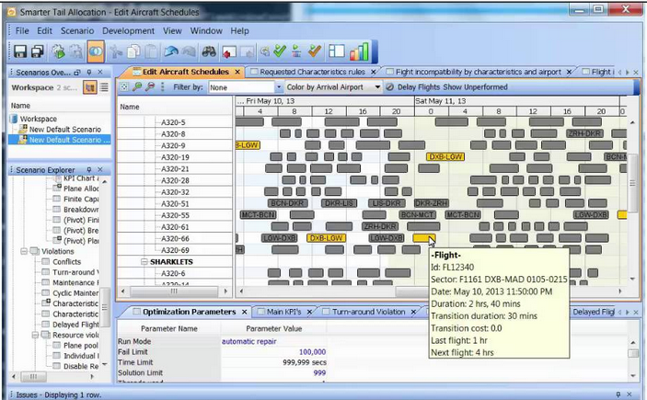
Prescriptive: Decision Optimization
y kg
Apply Operational Research (O/R) techniques
Two main technologies
Linear Programming
Used for resource allocation problems
Examples:
The Knapsack problem
Unit Commitment
Travelling Salesman
Constraint Programming
Used for Complex Planning and Scheduling problems
Examples:
Staff planning, construction planning
assembly lines, supply chain logistics
z kg
?
γ kg
x kg
Σ<=n kg

Slide 24
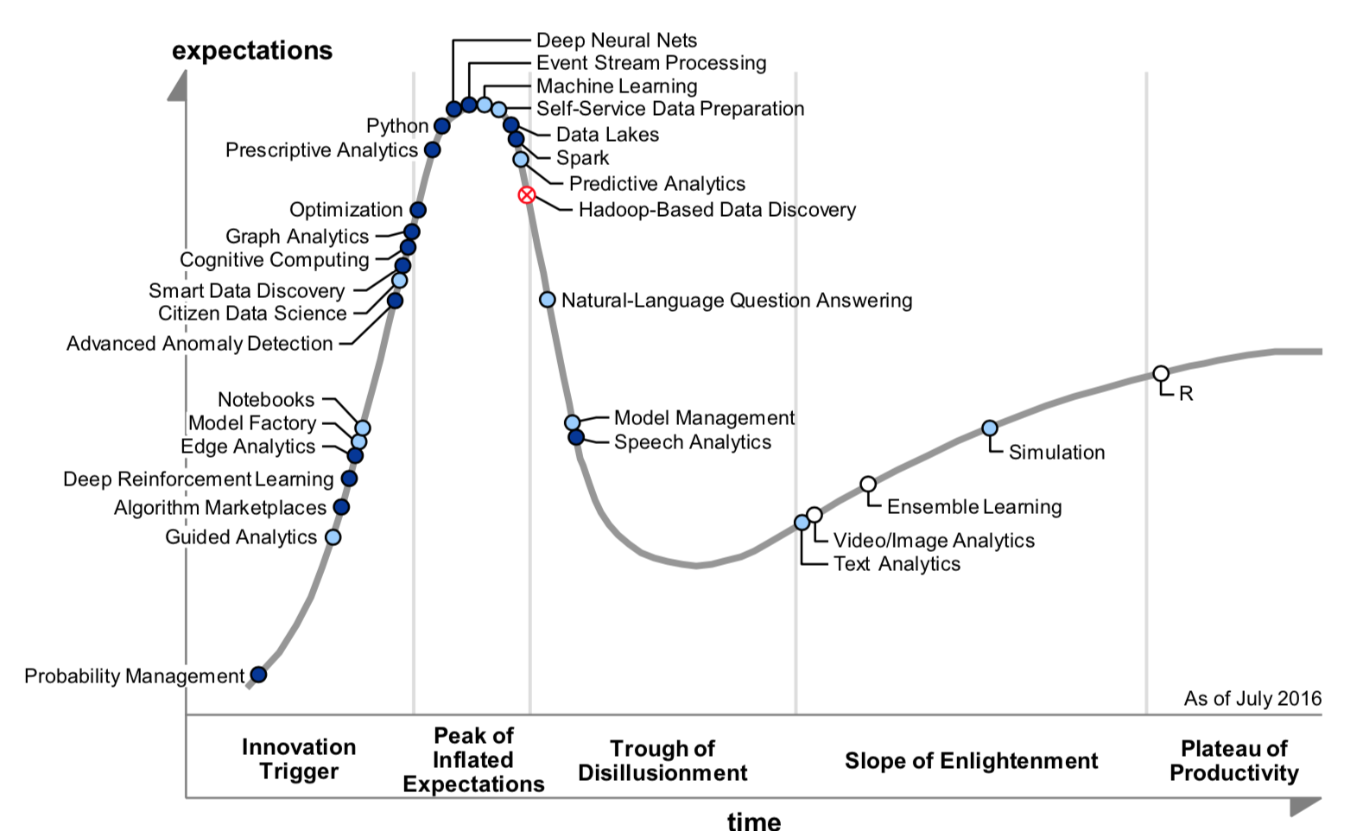
Decision Optimization Proposition - What’s In It For Me
Machine Learning
Gartner Report G00326363 – May 2017 Forecast Snapshot: Prescriptive Analytics, Worldwide, 2017:
“The prescriptive analytics software market will reach $1.57 billion by 2021, with a 21% CAGR from 2016. Currently, 10% of organizations have some form of prescriptive analytics; this will grow to 36% by 2021.”
Optimization
Gartner Report G00303293 – Hype Cycle for Data Science
Notes:
It is also important for the IBM Sales and Tech Sales teams to understand that Prescriptive Analytics and the IBM Decision Optimization product line is an important item in their portfolio that can help them retire quota and be successful within IBM.
The quote from Gartner shows the market potential for Prescriptive Analytics, $1.1 billion by 2019. Unlike, Descriptive Analytics where the market is mature with plenty of competitors and Predictive Analytics that faces serious competition from open source, Prescriptive Analytics has a lot of room to grow and IBM can grab a big part of that market. Currently there is a lot of white space with only 10% of organizations using prescriptive technologies. This is projected to grow to 35% by 2020.

Slide 25
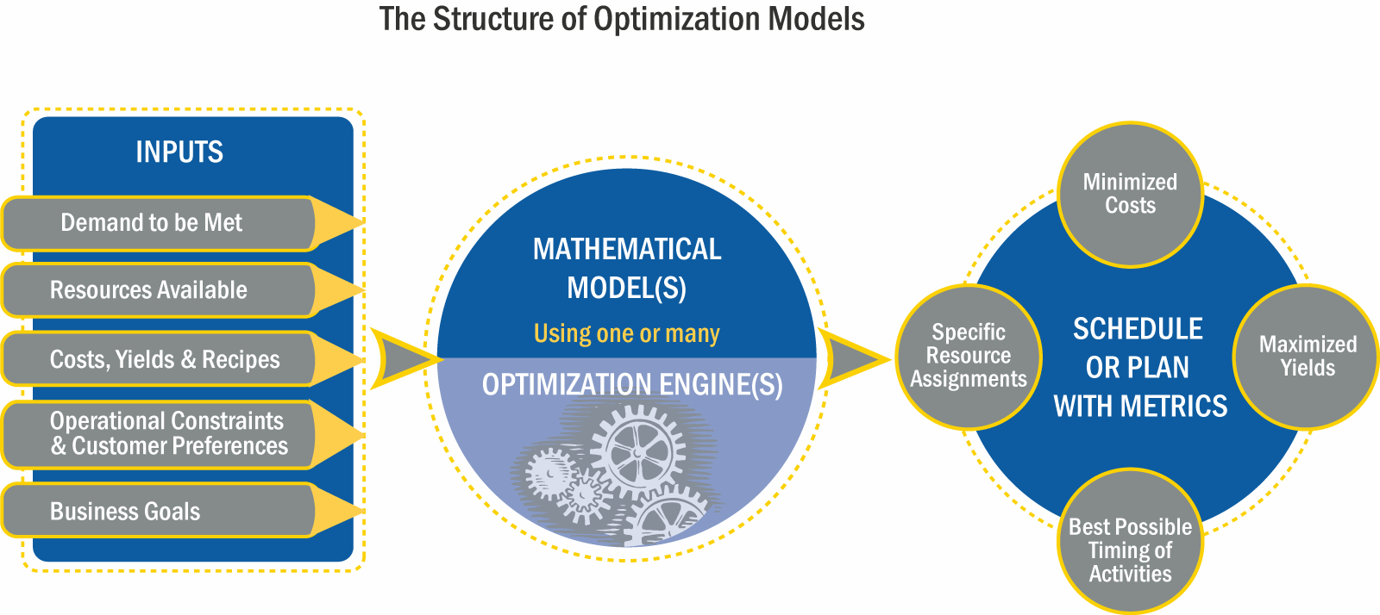
Prescriptive Analytics – How Does It Work?
In many cases ”Demand to be Met” comes from a Predictive Analytics Solution like SPSS
The model is typically created by an “O/R Expert” and is specific to the business problem and industry
Output is typically written back to an ERP or a DB and can be consumed through a BI solution
2
3
5
Inputs typically come from ERP systems, siloed DBs or entered manually
The engine is the run-time component of the IBM Decision Optimization software
1
4
Notes:
Fundamentally the prescriptive analytics / optimization technology and our IBM Decision Optimization products work very similarly to all other analytics technologies and tools.
At first, they need to consume various sets of data that are typically available in ERPs or DBs of one or more departments across the enterprise. It is also common for specific inputs to be manual. In most cases the inputs have to do with the resources that are available and have to be managed, the demand that needs to be satisfied by these resources, additional costs of using resources, and rules of when each resource can be applied or other capacities. Finally, there are business goals that users are typically interested in and define what makes one solution better than another. For example total cost, or revenue or service level to name a few.
Out of all of these in most cases the demand piece might come from a predictive analytics solution like SPSS. However, in organizations that have not implemented any predictive analytics solution this input could simply come from individual estimates or historical averages or a combination of both.
The third step is critical and common to all analytics. An expert has to build a model that consumes the inputs. This model is simply a representation of what can and cannot happen in the business world. Just like a data scientists or statistician builds an SPSS stream an Operations Research professional or Industrial Engineer typically builds an optimization model. Several modeling examples and tutorials are available with the IBM Decision Optimization product distributions. Certain products also contain a modeling environment that make the construction and debugging of models simple.
Once the model is built we load it with the input data to create a problem instance and pass that to the optimization engine. The engine is at that heart our IBM Decision Optimization products. It uses advanced algebraic procedures to determine the best, according to the goals, alternative out of millions if not billions of possibilities in a short amount of time. When finished the engine returns the choices that will result in the maximization or minimization of the selected goals.
The engine choices are typically written back to an ERP system or a DB or can be reviewed through a business intelligence solution like IBM Cognos.
Ideally this process is streamlined and in control of the business user who reviews the result of one solution, changes one of the inputs to create a "what-if” scenario, solves that scenario and compares the two solutions. Once the user is satisfied with one of the solutions they can submit it to their official execution system.

Slide 26
What Is an Optimization Model?
A translation of your business problem into math
Business goals / KPIs
Increase profits
Model objectives
Maximize Profit
Levers / decisions affecting goals
How much product A should we produce?
Model variables
Production_ProductA
Business “rules” constraining decisions
Production must be less than plant capacity
Model constraints
Production_ProductA ≤ Capacity_A
Describe key parameters of the problem, not how to solve it!
Notes:
In all optimization models there are three key constructs that are necessary for the optimization engine to return a solution.
1) The Business Goals (in business terms) or Objectives (in math). An example of an objective (or business goal) is “Maximize Profit”. These are typically the key performance indicators that the business is trying to improve (either increase or decrease). It is common for real world business problems to have multiple Business Goals and as a result the corresponding optimization models will have multiple objectives. For example a company might be looking to maximize profits and minimize cost and maximize service level to customers.
2) The Decisions (in business terms) or Variables (in math). These are the assignments/schedules/plans/routes/allocations that the business is struggling to decide on. An example of a Decision is “how much product A to produce?” (typically in a certain location and a certain time period). In the mathematical model this will be represented by a specific variable, say “X”, or “Production_ProductA” or something equivalent. In a typical optimization model you would have hundreds of thousands and sometimes millions of variables. Typically the more variables you take into consideration the more detailed and valuable your model and solution becomes.
3) The Business Rules (in business terms) or Constraints (in math). These are the rules or constraints that the decisions need to respect. For example “production must be less than the plan capacity”. This would correspond to a constraint in the optimization model that says “Production_ProductA <= Capacity”. In a typical optimization model you can have dozens of different constraints types, like respect a capacity, respect a product flow connection from location to location, respect precedence constraints between tasks, etc.

Slide 27





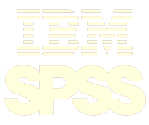
IBM Decision Optimization – Portfolio and Integrations
IBM CPLEX Optimization Studio (COS) | IBM Decision Optimization on Cloud (DOcplexcloud) | IBM Decision Optimization Center (DOC)
Key Capabilities: Modeling environment Prescriptive Analytics Engines | Key Capabilities: Self-serve web page Prescriptive Analytics Engines | Key Capabilities: GUI for Business Users Application Data Model Business Process Support Modeling environment Prescriptive Analytics Engines
Deployment: On-premise through APIs | Deployment: Cloud through APIs | Deployment: Client-Server Architecture
Personas: OR professional (or Data Scientist) IT | Personas: OR professional (or Data Scientist) IT | Personas: OR professional (or Data Scientist) IT Line of business
Portfolio
Data Science Experience
Planning Analytics
IBM Cloud
SPSS Modeler
Integrations
DSX Local includes COS CE
Can be consumed from Notebooks and R-studio
Published connector to COS and DOcplexcloud on devWorks
DOcplexcloud included in the IBM Cloud catalog
CPLEX node in Modeler
Modeler includes COS CE
Notes:
There are 3 products in the IBM Decision Optimization portfolio.
CPLEX Optimization Studio or COS for short offers a modeling environment so that the Operations Research (OR) professional or Data Scientist can write models. It also allows the OR user to solve models with the underlying optimization engines. There are also several application programming interfaces (APIs) that allow IT to connect the model and engine to data sources and take the output and export it to other systems.
Decision Optimization on the Cloud or DOcplexcloud for short is effectively COS on the cloud. There are some limitations as the cloud offering is new but in general all of the execution that can happen through COS on premise can now take place on the cloud. There is no modeling environment on the cloud. The OR users have to use a free COS version that lacks the execution component to build their models locally before sending them to the cloud for execution. OR and IT users communicate with the cloud service through various APIs.
Decision Optimization Center or DOC for short is a platform meant for the development and deployment of complete end-to-end decision support applications. It contains a development environment that can be used by OR users for model building and by IT users for building a Graphical User Interface and an Application Data Model to import and export data and integrate with existing systems. It can support different user roles and business processes and allows the business user to trigger and complete all steps from the previous slide, like data import, solve, compare, data export etc. For deployment there are server components that need to be installed on an existing application server and a windows client for the business users. However, the platform is modular and there are APIs for all modules. As a result it is possible to have a Web UI connected with the server components or the execution done on the cloud using the DOcplexcloud service.

Slide 28
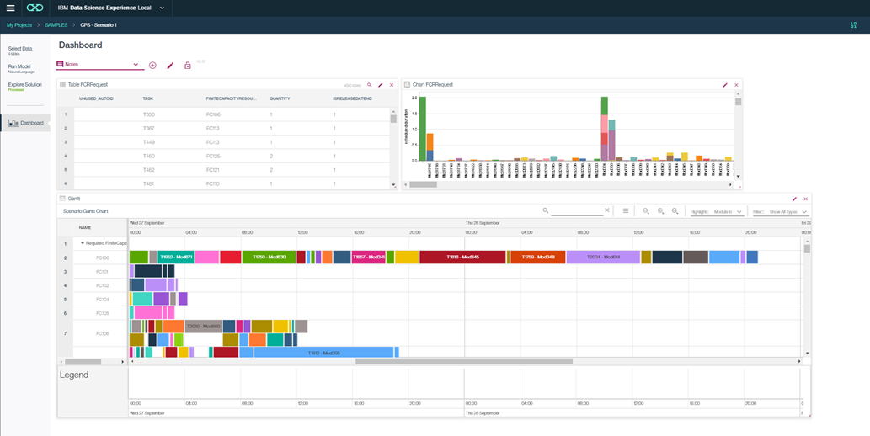
Decision Optimization for Data Science (DODS), DSX Local
Visual multi-tab configurable dashboards
To validate the model, by exploring the solution
Comparison between scenarios…

Slide 29
Deployment Options

Slide 30
DSX Local
DSX is available both as a cloud offering or as a on-premises
This is the DSX Local product
DSX Local value proposition:
Provide a ready-to-run Data Science environment based on standards
Jupyter, Zeppelin, Spark, R Studio, …
Remove the burden of managing an I/T infrastructure from DS team.
Efficiently manage collaboration across a Data Science team
Manage sharing of Data Processing cluster computing resources
Monitoring and resources allocation management
RAM, CPU, Storage, GPUs
Management of security, backups and resiliency

Slide 31
IBM Data Science Experience Local – Differentiation
Build on Open Source with Value Adds
Open Source: Apache Spark, Jupyter, Zeppelin, R Studio and R, Python and Scala.
Value Adds: SPSS, Decision Optimization and Streams
Applying AI to the process of doing AI
IBM Machine Learning help data scientists to automatically build models, maintaining and retraining them when performance drops.
Operationalizing data science
Model deployment and management
Managing hybrid workloads
Train on cloud using weather and social media data and deploy locally
Train locally using proprietary data and deploy on cloud for public access

Slide 32




IBM Data Science Experience – Why Local?
While organizations are increasingly embracing the public cloud, many require analytics operating locally within their firewall.
Sensitivity and security of corporate data
Bring data science to enterprise data
Performance from low latency, local data access
Industry specific security requirements
Managed open source innovation
DSX Local complements public capabilities and allows for IBM differentiation and hybrid use cases and deployment options
On-Premises
Private
Public

Slide 33

DSX Local Architecture
LDAP/AD
(Authentication)
GitHub
& GitHub Enterprise
Spark
Cluster
(with Livy)
Relational Data Stores
Hadoop
(HDFS, Hive, IBM Big SQL)
Data Scientist - Browser
(projects & assets)
(DB2,Oracle, Teradata, etc.)
Customer
Systems
DSX Local
Cluster
Kubernetes cluster spread across multiple dedicated servers
Start with 3 nodes with HA enabled
Expand as needed
Control
nodes
Compute
nodes
Storage
nodes
Download
& Go
Admin Dashboards
DSX UI Services
Redis
Packages
Kubernetes Cluster
glusterfs
Metering
Monitoring
Jupyter Notebook Service
Rstudio Service
Project Services,
Assets
(+ git)
& Data Svcs
Updates
Kubernetes
Master Components
Share user volume
DSX-Spark Service
csv files, projects
Storage
Apache Zeppelin
Model
Mgmt
Cloudant Local

Slide 34
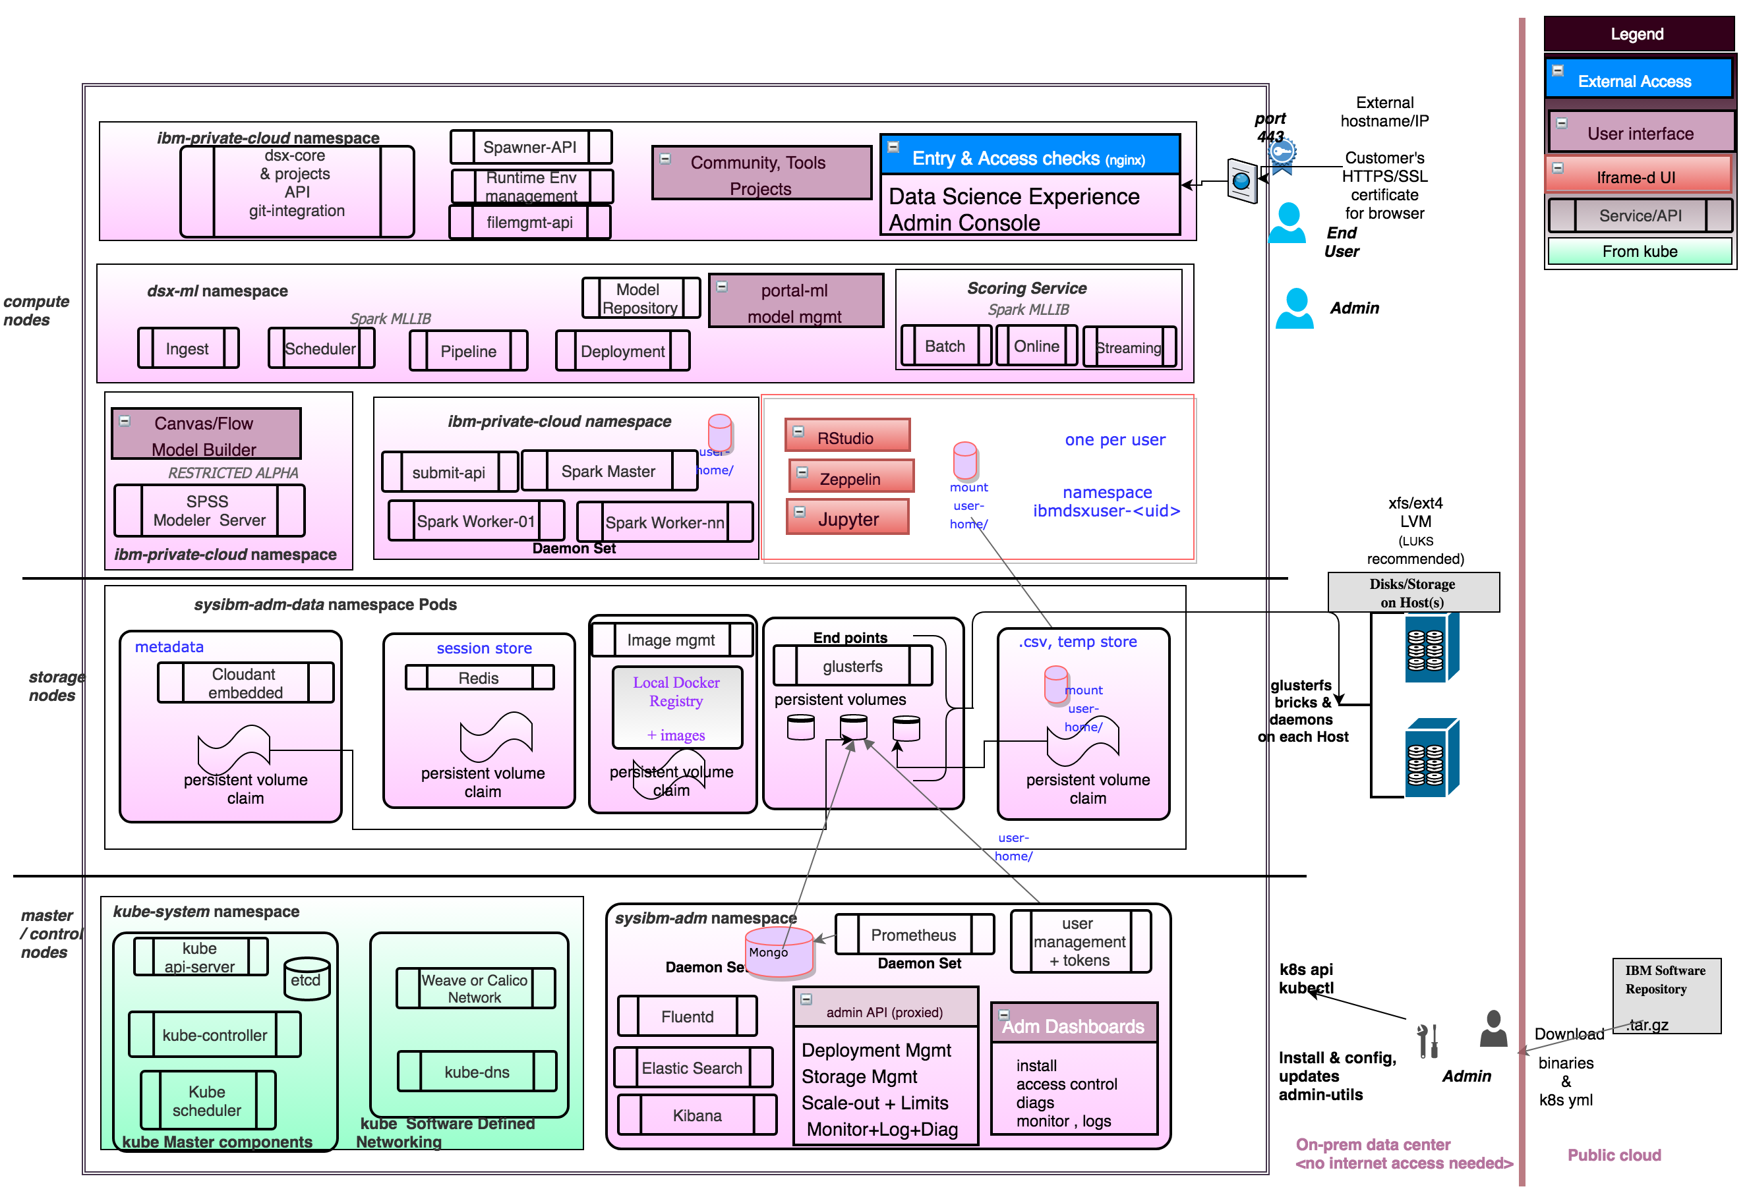
DSX components on top of Kubernetes
Running a DataScience cluster is a complex task

Slide 35
DSX Local: an idea of sizing requirements
Configuration | CPU | Memory | Disk
Base 3 node DSX requirements – total resources across cluster | 6 | 40 | 500 GB (installation)
Base 9 node DSX requirements (no users ) – total resources across cluster | 12 | 60 | 500 GB (installation)
Hardware requirement per concurrent user | 2 (x86-64) 1 (Power) | 10 *Based on 2 default environments deployed
Storage partition (for files) |  |  | Depends on the size of data

Slide 36
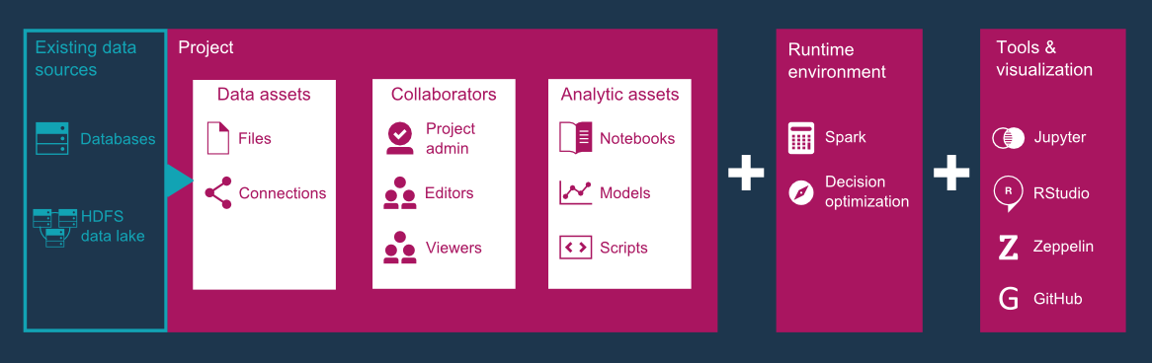
IBM Data Science Experience Local – Key Features

Slide 37
Lab 7
Continuous Learning Lab:
Lab7-WMLContinuousLearning.pdf
DB2 connection:
DataBase: BLUDB
hostname: dashdb-entry-yp-dal10-01.services.dal.bluemix.net
password: dbpGOA_13I_j
username: dash100270
In Box file: DB2WHCredentials.json

Slide 38
Thank You philippe.gregoire@fr.ibm.com

Slide 39
Notices and Disclaimers
Copyright © 2016 by International Business Machines Corporation (IBM). No part of this document may be reproduced or transmitted in any form without written permission from IBM.
U.S. Government Users Restricted Rights - Use, duplication or disclosure restricted by GSA ADP Schedule Contract with IBM.
Information in these presentations (including information relating to products that have not yet been announced by IBM) has been reviewed for accuracy as of the date of initial publication and could include unintentional technical or typographical errors. IBM shall have no responsibility to update this information. THIS DOCUMENT IS DISTRIBUTED "AS IS" WITHOUT ANY WARRANTY, EITHER EXPRESS OR IMPLIED. IN NO EVENT SHALL IBM BE LIABLE FOR ANY DAMAGE ARISING FROM THE USE OF THIS INFORMATION, INCLUDING BUT NOT LIMITED TO, LOSS OF DATA, BUSINESS INTERRUPTION, LOSS OF PROFIT OR LOSS OF OPPORTUNITY. IBM products and services are warranted according to the terms and conditions of the agreements under which they are provided.
IBM products are manufactured from new parts or new and used parts. In some cases, a product may not be new and may have been previously installed. Regardless, our warranty terms apply.”
Any statements regarding IBM's future direction, intent or product plans are subject to change or withdrawal without notice.
Performance data contained herein was generally obtained in a controlled, isolated environments. Customer examples are presented as illustrations of how those customers have used IBM products and the results they may have achieved. Actual performance, cost, savings or other results in other operating environments may vary.
References in this document to IBM products, programs, or services does not imply that IBM intends to make such products, programs or services available in all countries in which IBM operates or does business.
Workshops, sessions and associated materials may have been prepared by independent session speakers, and do not necessarily reflect the views of IBM. All materials and discussions are provided for informational purposes only, and are neither intended to, nor shall constitute legal or other guidance or advice to any individual participant or their specific situation.
It is the customer’s responsibility to insure its own compliance with legal requirements and to obtain advice of competent legal counsel as to the identification and interpretation of any relevant laws and regulatory requirements that may affect the customer’s business and any actions the customer may need to take to comply with such laws. IBM does not provide legal advice or represent or warrant that its services or products will ensure that the customer is in compliance with any law

Slide 40
Notices and Disclaimers Con’t.
Information concerning non-IBM products was obtained from the suppliers of those products, their published announcements or other publicly available sources. IBM has not tested those products in connection with this publication and cannot confirm the accuracy of performance, compatibility or any other claims related to non-IBM products. Questions on the capabilities of non-IBM products should be addressed to the suppliers of those products. IBM does not warrant the quality of any third-party products, or the ability of any such third-party products to interoperate with IBM’s products. IBM EXPRESSLY DISCLAIMS ALL WARRANTIES, EXPRESSED OR IMPLIED, INCLUDING BUT NOT LIMITED TO, THE IMPLIED WARRANTIES OF MERCHANTABILITY AND FITNESS FOR A PARTICULAR PURPOSE.
The provision of the information contained h erein is not intended to, and does not, grant any right or license under any IBM patents, copyrights, trademarks or other intellectual property right.
IBM, the IBM logo, ibm.com, Aspera®, Bluemix, Blueworks Live, CICS, Clearcase, Cognos®, DOORS®, Emptoris®, Enterprise Document Management System™, FASP®, FileNet®, Global Business Services ®, Global Technology Services ®, IBM ExperienceOne™, IBM SmartCloud®, IBM Social Business®, Information on Demand, ILOG, Maximo®, MQIntegrator®, MQSeries®, Netcool®, OMEGAMON, OpenPower, PureAnalytics™, PureApplication®, pureCluster™, PureCoverage®, PureData®, PureExperience®, PureFlex®, pureQuery®, pureScale®, PureSystems®, QRadar®, Rational®, Rhapsody®, Smarter Commerce®, SoDA, SPSS, Sterling Commerce®, StoredIQ, Tealeaf®, Tivoli®, Trusteer®, Unica®, urban{code}®, Watson, WebSphere®, Worklight®, X-Force® and System z® Z/OS, are trademarks of International Business Machines Corporation, registered in many jurisdictions worldwide. Other product and service names might be trademarks of IBM or other companies. A current list of IBM trademarks is available on the Web at "Copyright and trademark information" at: www.ibm.com/legal/copytrade.shtml.

